Slide 1


Session 1: Introduction to R and R studio

Slide 2
Background
This material aims to provide a manual that will be used by the ACAI NARS partners to train R users. The questions we asked ourselves before coming up with this content were:
What would be the best way to reach a high number of users with the training content?
And what would be the best way to make sure the lessons learnt at the training remain active?
The training team came up with 2 solutions:
Stepping the training down to researchers who are running field experiments this year and who will be facing problems to be solved that are part of the training package
The participants of the ToT implement the lessons learnt to a hypothetical problem as part 2 of the training.
Who would benefit from this training?
Those who have attended the previous trainings and have a clear grasp of the basics of R. This is a linear training in the sense that it solves some of the most common issues that arise from data management and visualization of field trial data. This training uses data collected using ODK and hosted on ona.io.

Slide 3
Previous trainings
May – July 2020: three virtual trainings “Introduction to R statistical programming language” --- Meklit Chernet (IITA) and Turry Ouma (IITA)
November 2020: In-person training with focus on intermediate and advance levels --- Ibnou Dieng (IITA), Meklit Chernet (IITA), Turry Ouma (IITA) and Sam Ofodile (IITA)
Feedback
There will be pre and post course online questionnaires hosted on ona.io to enable us get feedback to improve future training sessions.

Slide 4
Is R and Rstudio same?
R is a programming language used for statistical computing and graphics. Rstudio is an integrated development environment (IDE) that provides an interface which allows users to write and edit programs in R by offering statistical packages, many convenient features and tools. You can use R on its own to write a program and run the code. It is however not the case with Rstudio since it can only be used together with R.
In order to use Rstudio your R version should be 3.0.1 or higher. The most recent version of R can be downloaded from CRAN, the Comprehensive R Archive Network.
If you already have R and/or RStudio installed, let’s get started!

Slide 5
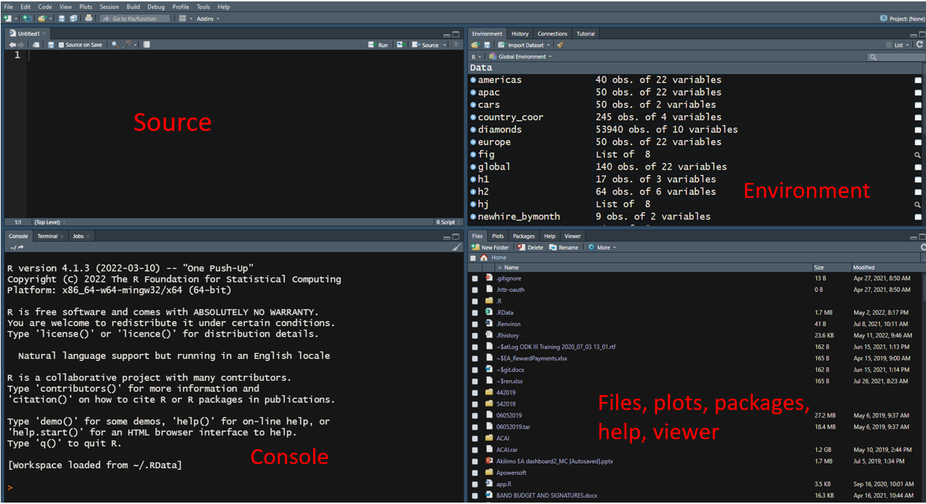

Slide 6
Before we start…
Set the Working directory
Create a folder called ACAI_R_training
Navigate to the file path and copy the path
Use setwd() to set the directory: Paste the path in between the parentheses: setwd("D:\Training Materials\ACAI_R_training")
In R, a single backslash is an escape character, and using it for directory paths will always produce an error.
Specify directory paths correctly in R, using a forward slash: setwd("D:/Training Materials/ACAI_R_training")

Slide 7
Install relevant packages
Let’s use ‘’tidyverse’’ as an example
Install it from CRAN with: install.packages("tidyverse") or from GitHub: devtools::install_github("tidyverse/tidyverse"). OR in the Files pane of RStudio: Click on the “Packages” tab, Click on “Install”, Type the name of the package under “Packages (separate multiple with space or comma):” Click “Install”
For GitHub you may need to install the {devtools} package. You can do this from CRAN with install.packages("devtools") then load the devtools package using library(devtools).
In most cases just use install_github(“author/package_name”) as shown in the example above.
Load it for use in R with: library("tidyverse").
Get help on it with: package? tidyverse and help(package = " tidyverse").

Slide 8
Prepare data
Read the data in R
We will use {readr} which is a part of the core {tidyverse} and supports seven file formats with seven read_ functions. For our case these two apply: read_csv() and write_csv().
read_csv("data/dataVAL_FR_PO.csv")
An alternative is to use read.csv which is inbuilt in base R and reads the data as a dataframe.
read.csv ("data/dataVAL_FR_PO.csv", header=T, na.strings=c("","NA"))
Now let’s assign this data frame to a variable so that it is stored in R’s memory:
dataVAL_FR_PO <- read_csv("data/dataVAL_FR_PO.csv")

